Slide 1
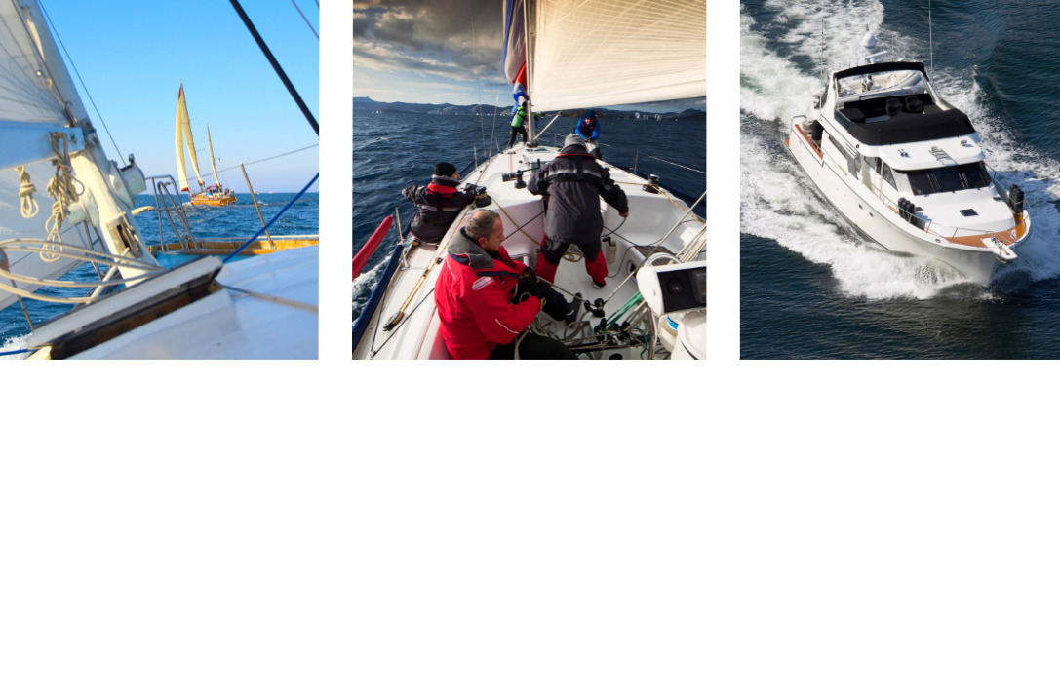
An Introduction to the
Cruising Association
Notes:
Welcome to this presentation about the Cruising Association, the leading organisation for cruising sailors and motorboaters.
It will tell you a bit about the CA’s history, then explain what it does today to support our members around the world.

Slide 2
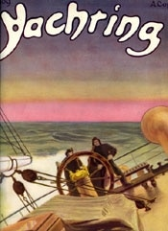
1908 Origins
“I allude to the ridiculous overcharging …
among the longshoremen of the land-shark variety”
“What Corinthian yachtsman has not experienced the keenness of the teeth of these vultures?”
A.D.Hownam-Meek
Letter to Yachting Weekly, 6 August 1908
Notes:
Cruising started to become popular from around 1880. Boats were made of wood, largely left on moorings, and were often gaff rigged. Gentlemen and ladies who indulged in the pastime needed crews, which were sometimes in short supply. Boatmen around the coasts saw an opportunity to make a profit from this new pastime. Some (as today) were rather less scrupulous than others. In 1908 AD Hownam-Meek wrote an apocryphal letter to the then Yachting Weekly…

Slide 3
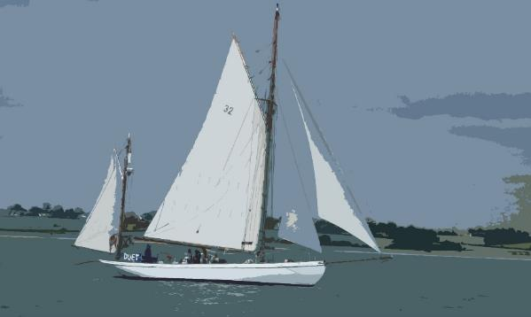
1908 Origins
“I know of more than one place where the anchorage is but 50-70 yards from the shore, but the local blood-sucker will not put the unfortunate yachtsman ashore for under 2 shillings …”
A.D.Hownam-Meek
Letter to Yachting Weekly 6 August 1908
Notes:
…complaining of unscrupulous practices.

Slide 4
Establishment of the Association
Editor of Yachting Weekly offered a room to discuss the ‘formation of an Association’
The first AGM was at the Bay Tree Tavern, St Swithin’s Lane, London EC on 14 December 1908
Membership was initially 125
Aim was to have a central office in London, with an ‘Information Bureau,’ where members could obtain full particulars of any and all cruising grounds around the British Isles and adjacent waters
Volunteers worked 4 or 5 nights a week at the ‘First Avenue’ pub
Notes:
The editor of Yachting Weekly took this up, a debate started, and before long a new association was formed.
The Cruising Club (later the Royal Cruising Club) had already been formed in 1880 but had remained somewhat exclusive; what was needed was a wider organisation, for all those interested in cruising as a new pastime.
The founders gathered and worked hard to create an initial ‘Information Bureau’.

Slide 5
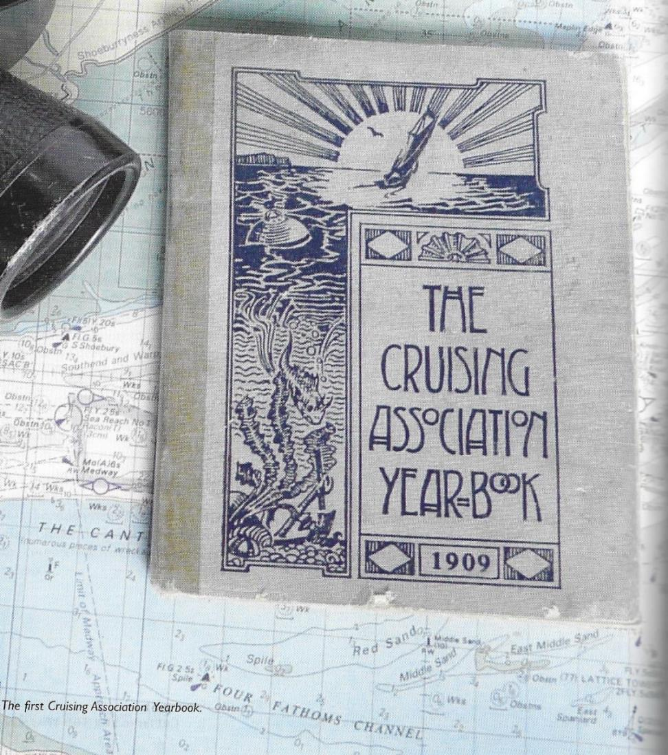
First Yearbook
Members’ names and boats
Dover tide tables
The Morse Code
Extracts from the Rules of the Road
Port register with recommended boatmen and details of facilities available
Passage notes
Sailing directions for 85 ports
Notes:
The first Yearbook was published in 1909 containing a wealth of useful information for members, as you can see.

Slide 6
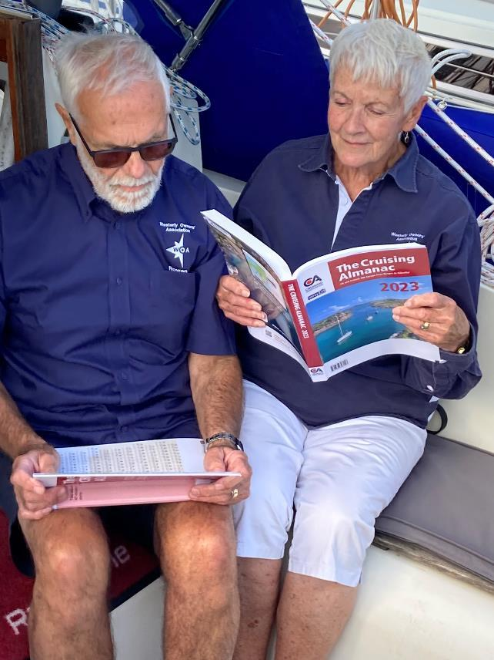
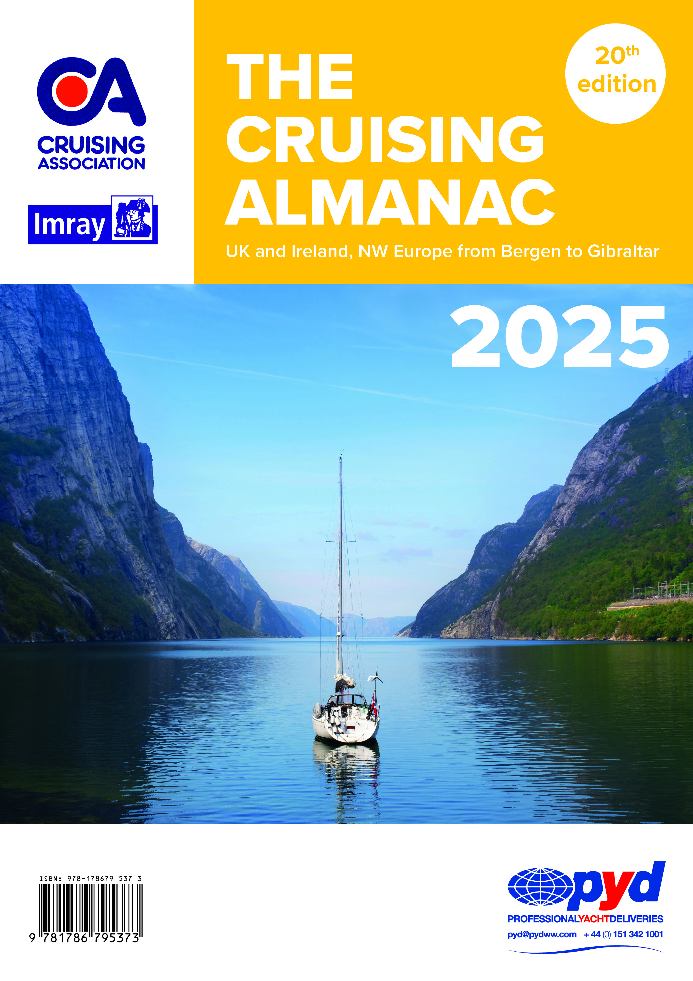
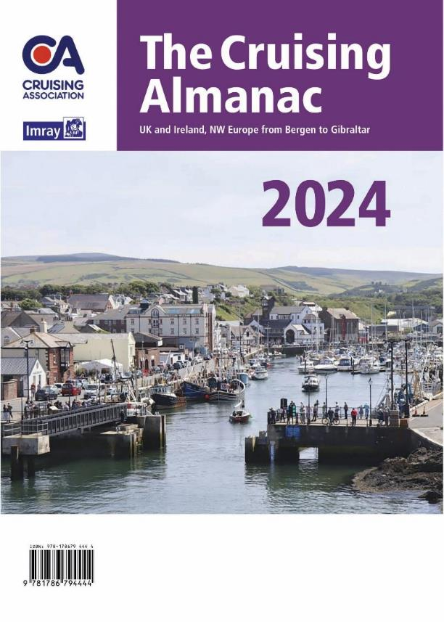
Today
A team of 20+ editors
Notes:
Its modern-day equivalent is the Cruising Almanac, produced with Imray. It now has a team of 20+ editors and is continually updated, with regular corrections sent out to Members.

Slide 7
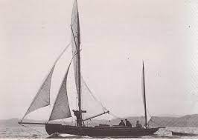
A Growing Association
By 1910
Navigation classes
Members’ signal flag
Organised cruises (Easter, Whitsun, August)
Annual dinner post AGM
Notes:
By 1910 the Association had started to grow, and it had widened its activities, as the slide shows.

Slide 8
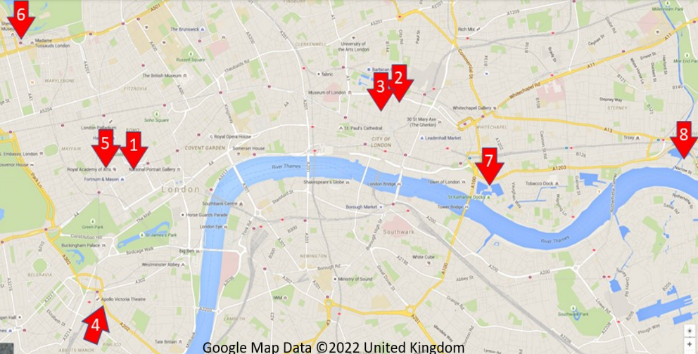
CA Headquarters
Over the years
1. 1909 / 199 Piccadilly, London
2. 1910 / 15 Copthall Avenue, London EC
3. 1912 / 10 Coleman Street, London EC
4. 1914-1922 / 49 Denison House, Victoria, London SW1
5. 1923-1930 / 16 Albermarle Street, London W1
6. 1930-1972 / Chiltern Court, Baker Street, London NW1
1973 / Library Information Store, Marylebone Road
7. 1974-1993 / Ivory House, St Katherine Dock, London, E1
8. 1994 / 1 Northey Street, Limehouse Basin, London, E14
Notes:
Over the years the CA has had several headquarters in London, and we are now at our 8th location. The longest occupied so far was property #6, at Chiltern Court by Baker Street, but the lease expired at the end of 1972 after 42 years. Between 1974 and 1993 the CA was based at St Katherine’s Dock.

Slide 9
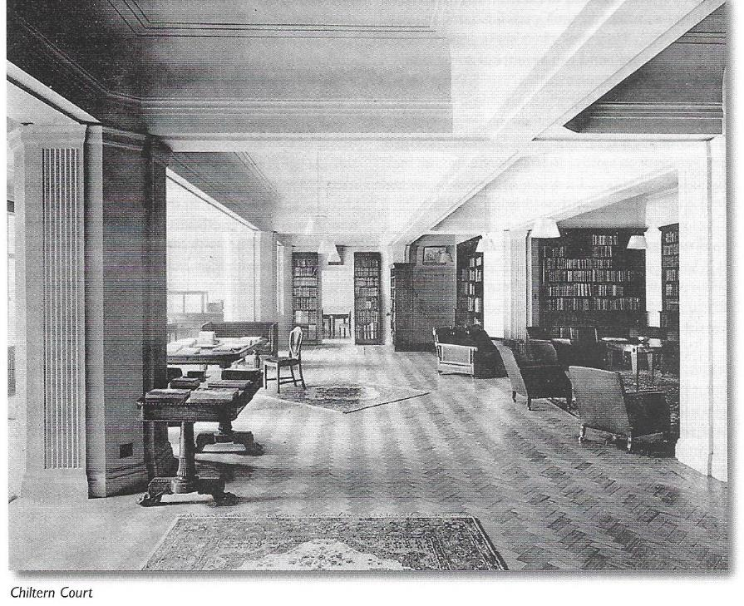
Chiltern Court
Notes:
Here is Chiltern Court, occupied by the CA from 1930 to 1972. It was a new block over Baker Street Station.

Slide 10
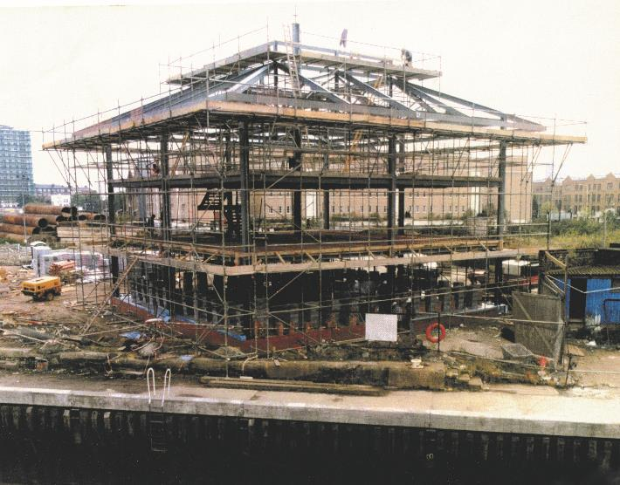
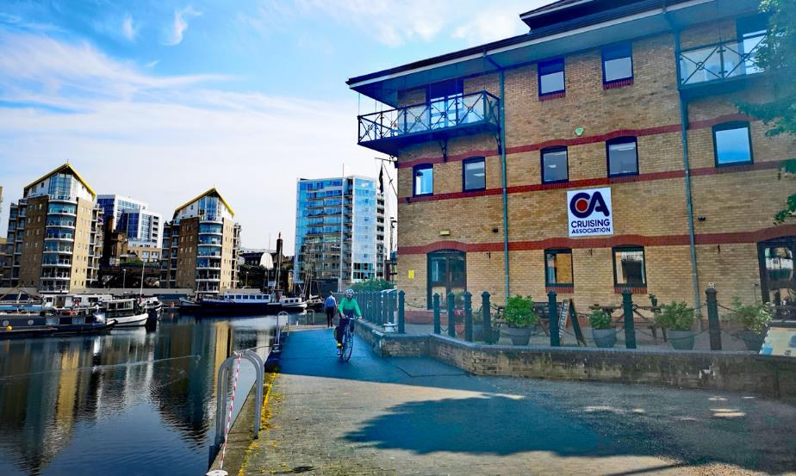
1994 – CA House
Notes:
The CA obtained a site adjacent to Limehouse basin on a long lease in the 1990s. The CA raised finance partly through the sale to Cambridge University Library of the valuable Hanson collection, and in 1994 built the current CA House. CA members can obtain a reader’s ticket to access the Hanson collection in Cambridge.
CA House is 10 mins’ walk from Limehouse DLR. A tenant occupies most of the top floor and another uses the Assembly Room during weekdays. It is has other occasional uses e.g. as polling station. The galley and bar now has a public licence.
The yearly running costs of the building are typically covered by our rental and galley income. The second floor is our headquarters, the home of the COO and her staff, and our library.
Link to the Hanson collection: https://www.lib.cam.ac.uk/collections/departments/rare-books/collections/hanson-collection

Slide 11
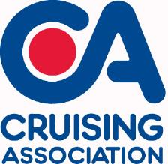
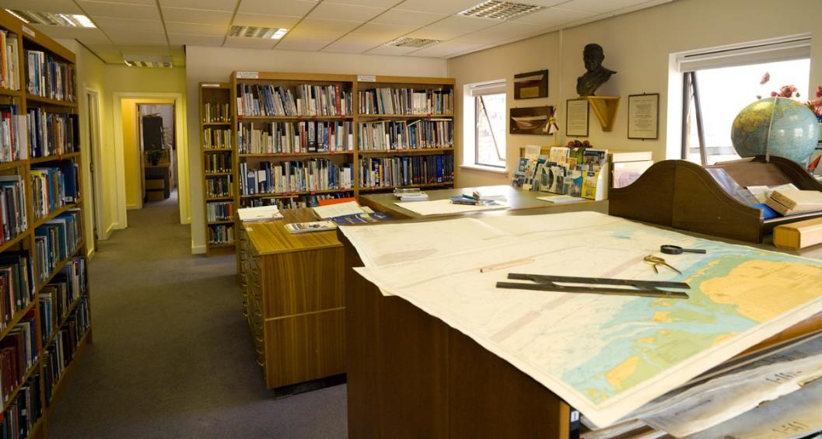
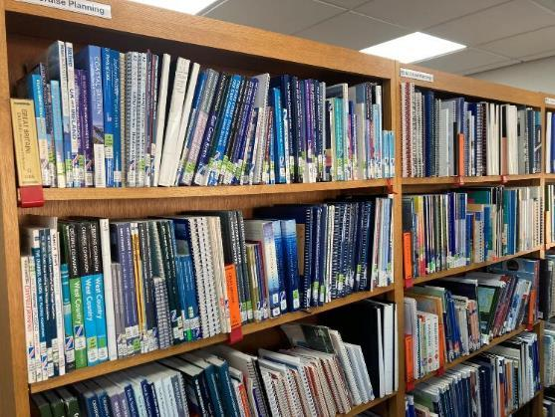
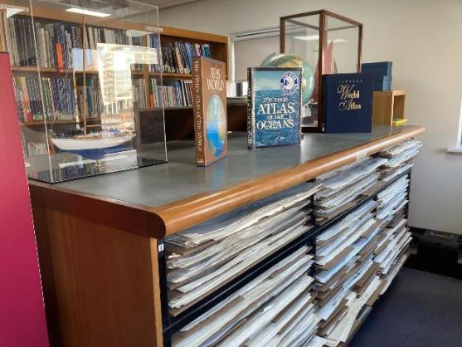
CA House
Home to the world’s largest maritime library
Notes:
The CA library is extensive, and members can take out books on ‘free’ loan. There is a wide array of charts (paper and electronic), the latest pilot books, and guides. It’s an ideal place to plan a cruise. Members can review an online catalogue too, and request books to loan without having to visit CA House.

Slide 12
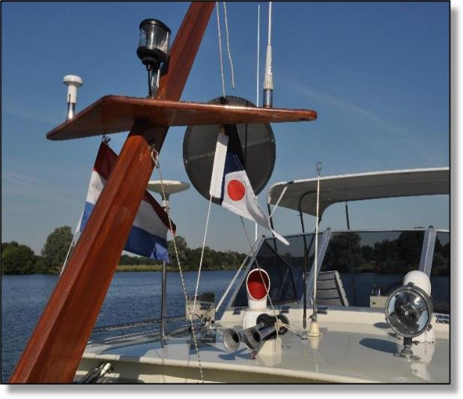
The CA Today
The UK’s leading organisation for cruising sailors and motorboaters
Limited Company run by a Council
Small permanent staff in Limehouse headed by Chief Operating Officer
200+ volunteer roles / c150 active volunteers
6300+ members
Turnover of c£1 million / year
Notes:
Today the CA is one of the world’s leading organisations for cruising sailors and motorboaters.
It is a limited company, run on a not-for-profit basis by a volunteer council, with a small permanent staff in Limehouse and many volunteers who contribute extensively to its many activities.
We currently have over 6000 members and a turnover of almost £1 million a year.

Slide 13
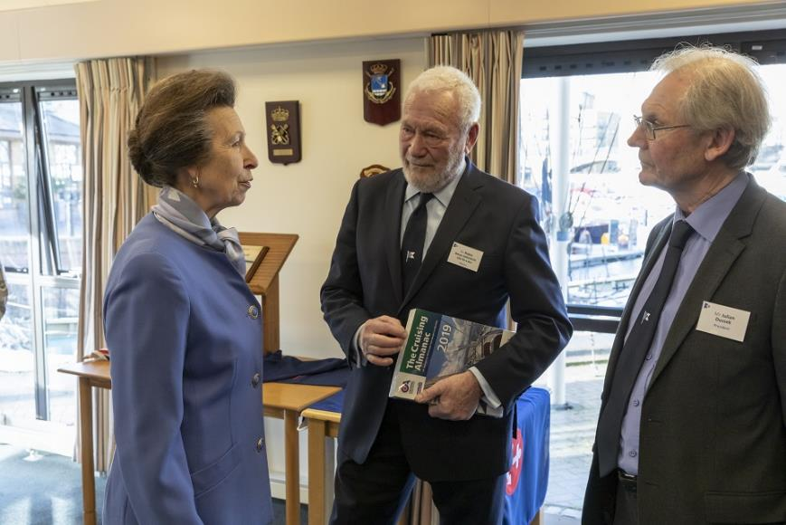
110th Anniversary - 2019
HRH The Princess Royal
CA Honorary Member
-
Sir Robin Knox-Johnston
CA Patron
-
Julian Dussek
CA President 2018-2021
Notes:
Sir Robin Knox-Johnston is our patron. Here he is pictured with The Princess Royal – who is a CA Honorary Member, and the then CA President Julian Dussek, on the occasion of the CA’s 110th Anniversary in 2019.

Slide 14
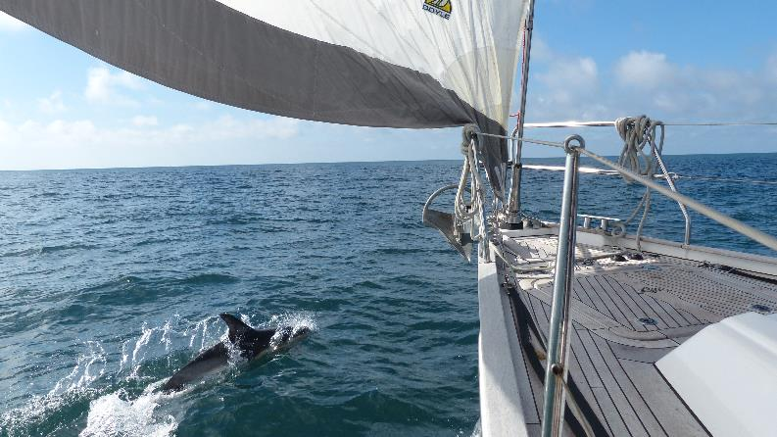
What the CA provides to members
Yearly Cruising Almanac produced with Imray
Extensive library, charts and pilot books
8 regional Cruising Sections and 9 Local Sections – events, rallies & cruises
Regulatory & Technical Services (RATS) Group advice
CAptain’s Mate
Honorary Local Representatives
Crewing Service
CA House - galley, cabins, lecture room, library
Extensive discounts worldwide
Cruising magazine quarterly and monthly e-newsletters
Online Cruising Advice and Forums
and much more …
Notes:
Today’s CA has many parts. In addition to the yearly Cruising Almanac and the library, it has:
a number of regional cruising, and local sections which organise regular talks, social events and cruises;
a committee called RATS which provides technical and regulatory information and advice, and lobbies on behalf of the cruising community;
CAptain’s Mate, the renowned and British Yachting Award winning app, which provides cruising information and reports from members via computer, tablet or mobile;
a worldwide network of Honorary Local Representatives (HLRs) to assist members;
Crewing Service to match boat owners with crew and vice-versa;
CA House with a galley restaurant and bar, library and information centre, en-suite rooms at very reasonable rates;
Extensive discounts from marine partners in the UK and overseas negotiated by us;
A quarterly magazine and monthly email newsletters to keep members up to date and share technical and cruising know-how;
Multiple online members’ forums for the exchange of information and advice.
This presentation will now cover each in turn.

Slide 15
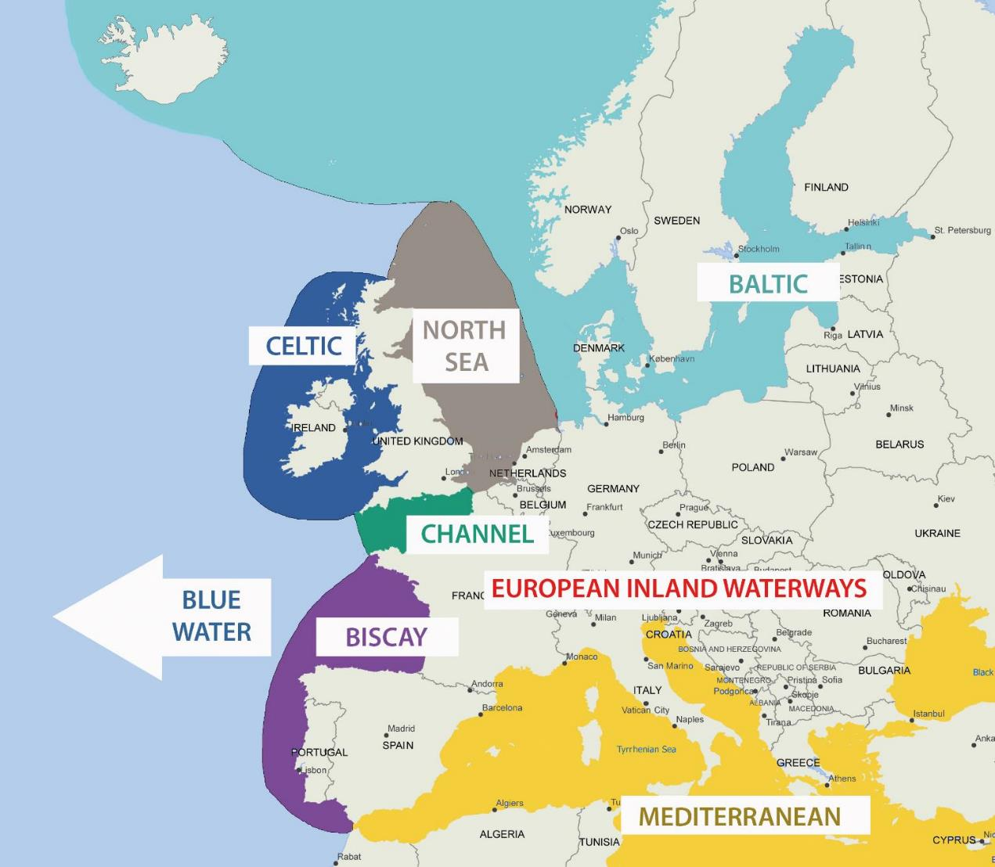
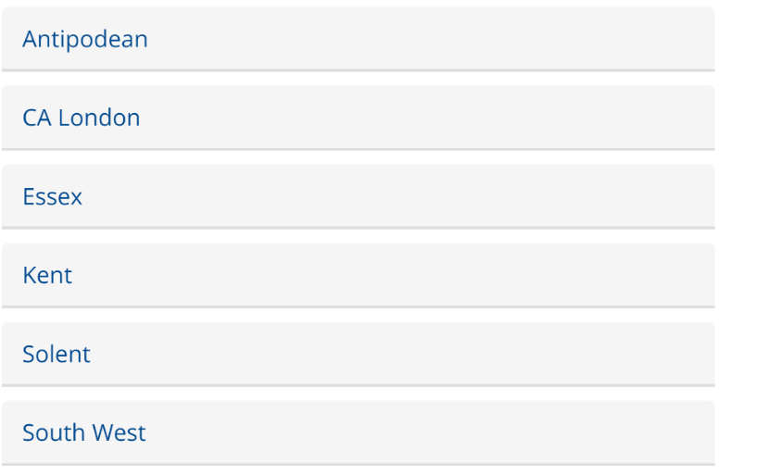
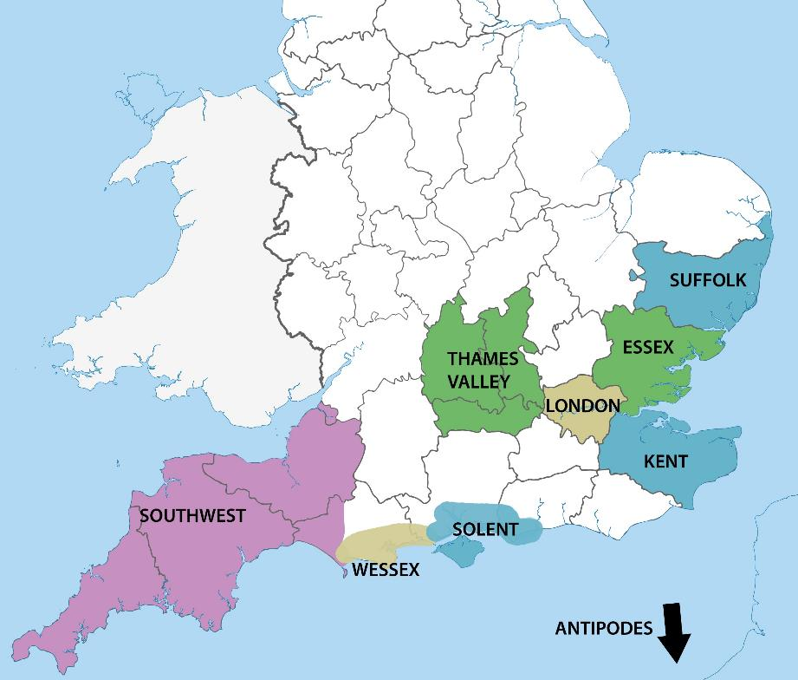
Cruising and Local Sections
Cruising
Local
Notes:
Turning first to our Sections, which comprise regional Cruising Sections and more local, UK based Sections.

Slide 16
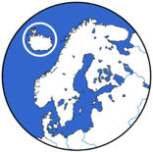







Cruising Sections
Baltic, Biscay, Bluewater, Celtic, Channel, European Inland Waterways, Mediterranean, North Sea
Responsible for supporting members in their cruising waters, with:
Cruising Guides
Information Days
Meets/Rallies
Cruising Information
Edit Cruising reports
Notes:
Our 8 Cruising Sections are run by volunteer members. The areas covered are those most frequently cruised by our members.
The sections publish a number of cruising guides; they hold information days where experts on the region give briefings and updates, and they organise meets and rallies, often annually. The experts in the Cruising Sections contribute hugely both to the Almanac and CAptain’s Mate, of which more later.

Slide 17
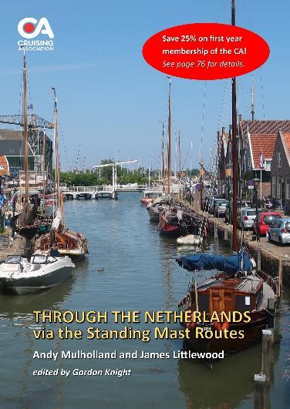
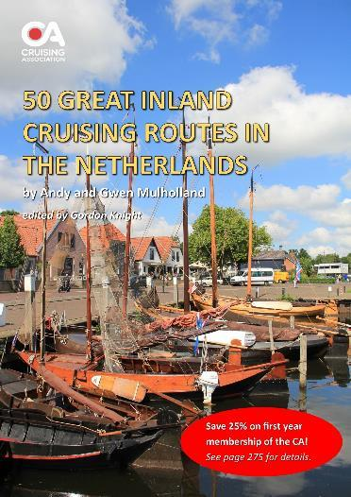
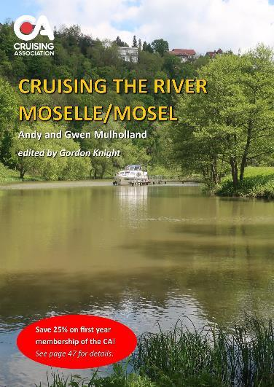
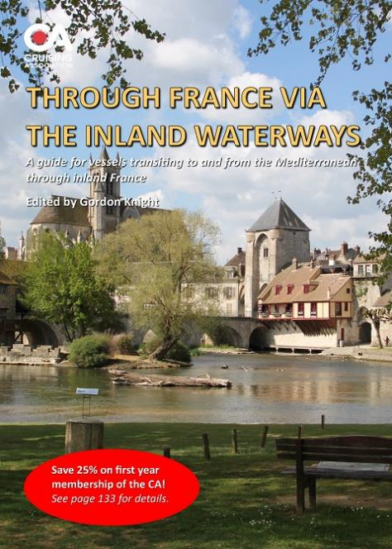
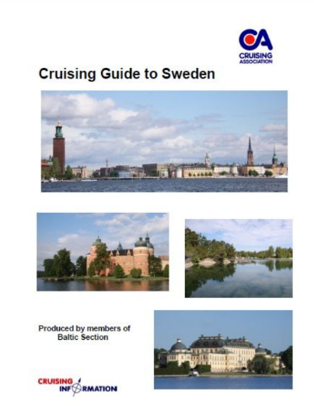
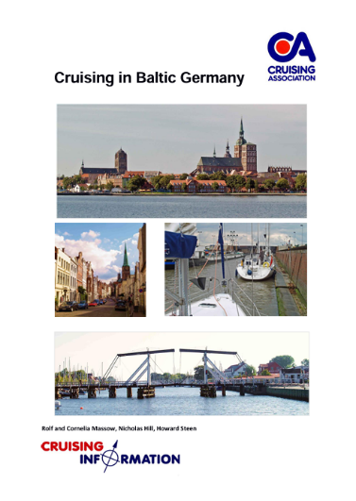
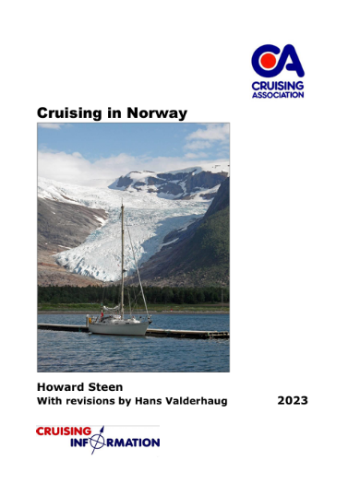
Cruising Sections
Notes:
Here are a few examples of our detailed Cruising Guides, produced and edited by our regional experts.
All the CA Cruising Guides are available for members to downloaded free of charge in PDF format.
The Cruising Sections often organise summer rallies. For example, it has been running Rallies in the Baltic since the Millennium, and arguably has the best English language cruising information resource for the Baltic in existence.

Slide 18
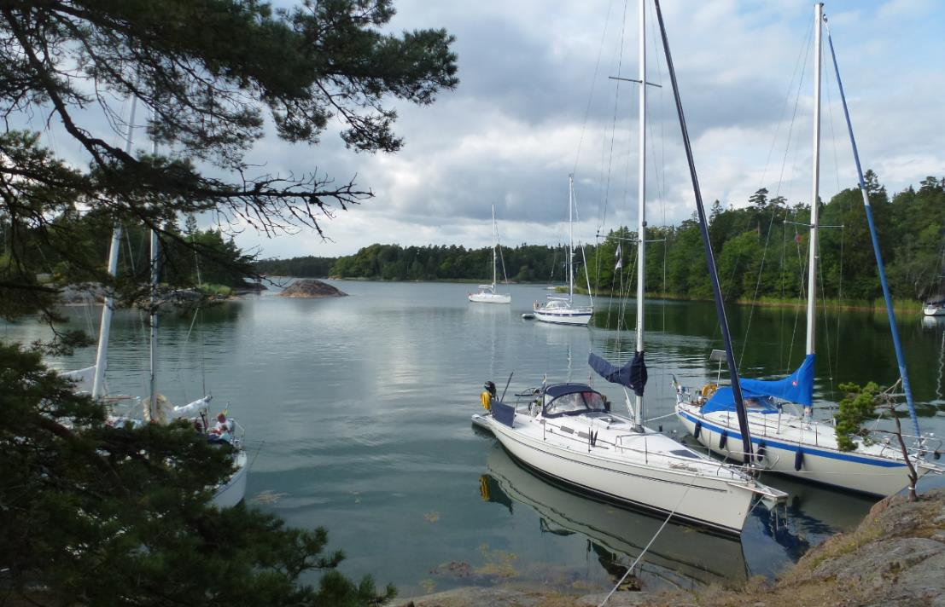
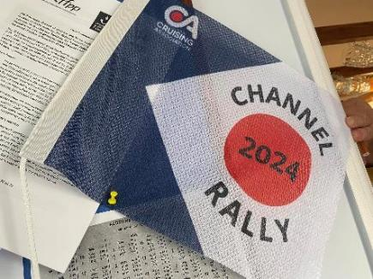
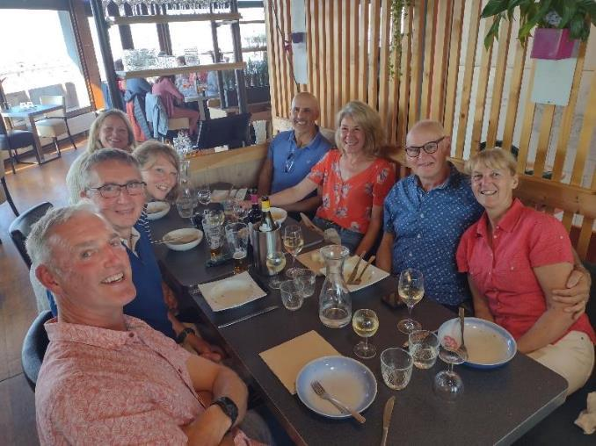
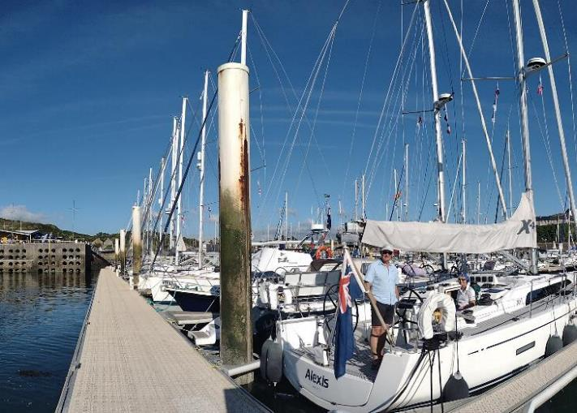
Rallies
Notes:
Here are a few photos from some past rallies, hosted by the Channel, Baltic and Biscay Sections ...

Slide 19
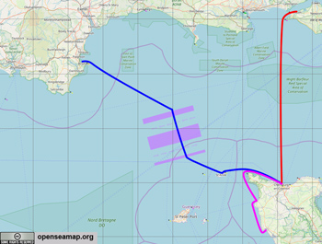
2024 Cross Channel Rally/Cruise in Company
Two Starting Points: Saturday 15 June - Brixham or Monday 17 June - Yarmouth / ending 27 June 2024
Visiting Alderney and France
Flotillas meeting together in Cherbourg
Sailing and socialising together
Dinners, pontoon drinks, bbq
Walks, visits and more leading organisation for cruising sailors and motorboaters
A CA Rally offers the attractions of cruising together, some local tourism opportunities, drinks and dinners and general socialising.
A CA Rally is an ideal opportunity for a first time Channel crossing with support and advice from others or an opportunity to cruise and socialise with friends old and new.
Notes:
…and here is an example of one of the rallies and cruises in company which took place in 2024. The Channel Section is heading to Northern France, with start points from both the West Country and the Isle of Wight in order to link into the various home ports of our members.

Slide 20
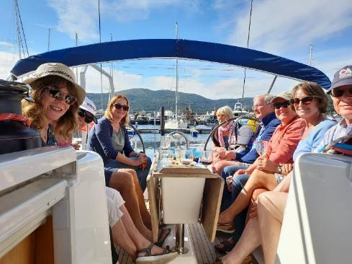
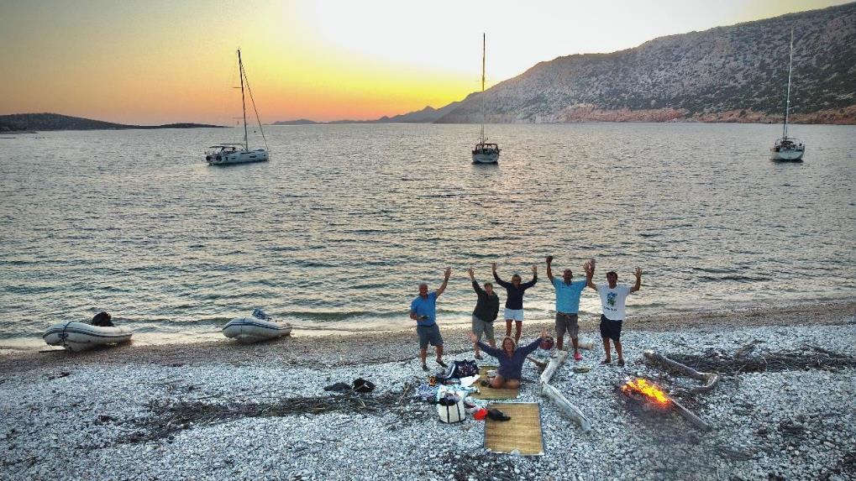
Local Sections
Antipodean, Essex, Kent, London, Solent, South West, Suffolk, Thames Valley, Wessex
Responsible for supporting members in their cruising waters, with:
Local Meetings/Talks
Visits
Rallies
Socials
Notes:
Our 9 Local Sections are also run by volunteer members. They arrange local talks and meets, and occasional visits. The aim is to connect CA members who live close to each other and provide a network to share cruising information and socialise.

Slide 21
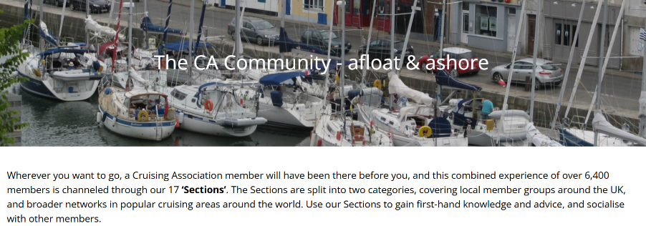

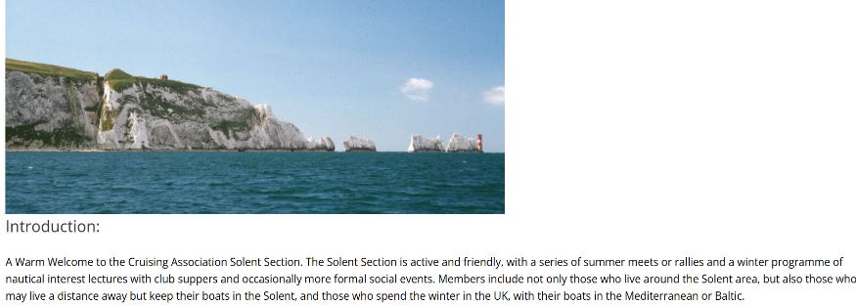
Local Sections
Notes:
Here is an example of the Solent Section page. On the CA website each Section has information on planned events, news and the contact details for the organiser.

Slide 22
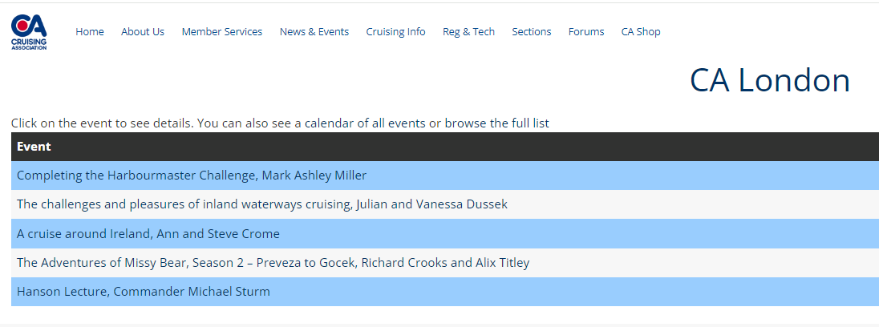

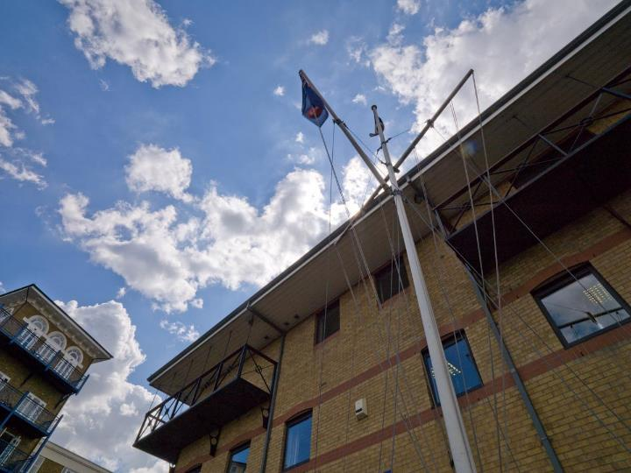
Local Sections
Notes:
Here is an example of the lectures in Spring 2024 organised by the London Section. Most lectures can be joined by Zoom.
CA members can join as many of the Cruising and Local Sections as they wish, and you will also receive the Section email updates and news.

Slide 23

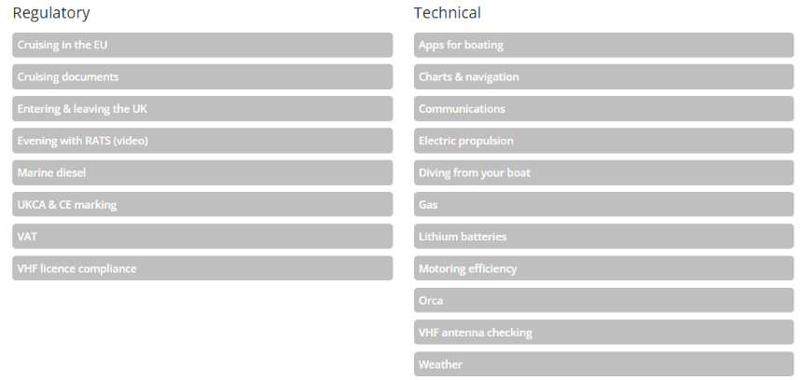
Regulatory & Technical Services (RATS)
RATS work on behalf of CA members by researching and answering questions on technical or regulatory subjects, or by making representation to local and national government
Hot Topics:
VAT, Orcas, Red Diesel,
90/180 Rules, HVO, RCD
Notes:
A significant part of our offer to members is RATS, the Regulatory & Technical Services group.
This group of CA volunteers studies and advises members on current issues, liaises with RYA and other maritime bodies, and undertakes lobbying of governmental institutions when it is felt appropriate to do so.

Slide 24

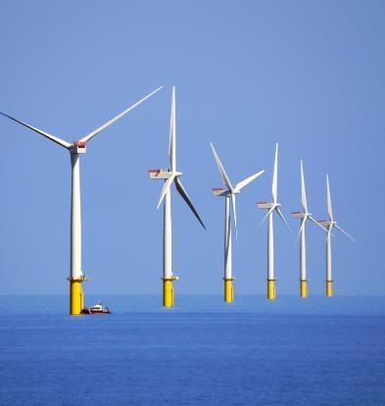
Regulatory & Technical Services (RATS)
Current RATS work includes:
Post Brexit: 90/180 days, UK entry and exit procedures, extended visas abroad, VAT and RCD/construction assessment regulations
Environmental matters: boat scrappage, eco moorings, marine conservation zones (MCZs), offshore installations, Li-Ion batteries and alternative electric propulsion, and Hydrotreated Vegetable Oil (HVO)
Re-filling gas cylinders
Orca interactions
Notes:
RATS is currently involved in a number of studies of a technical and regulatory nature. Key themes are:
the long-term consequences of Brexit;
a number of environmental matters;
specific issues which come up, such as the extensive research and liaison which has taken place over orca interactions off the Iberian coast;
other matters of a regulatory and technical nature of interest to members.

Slide 25
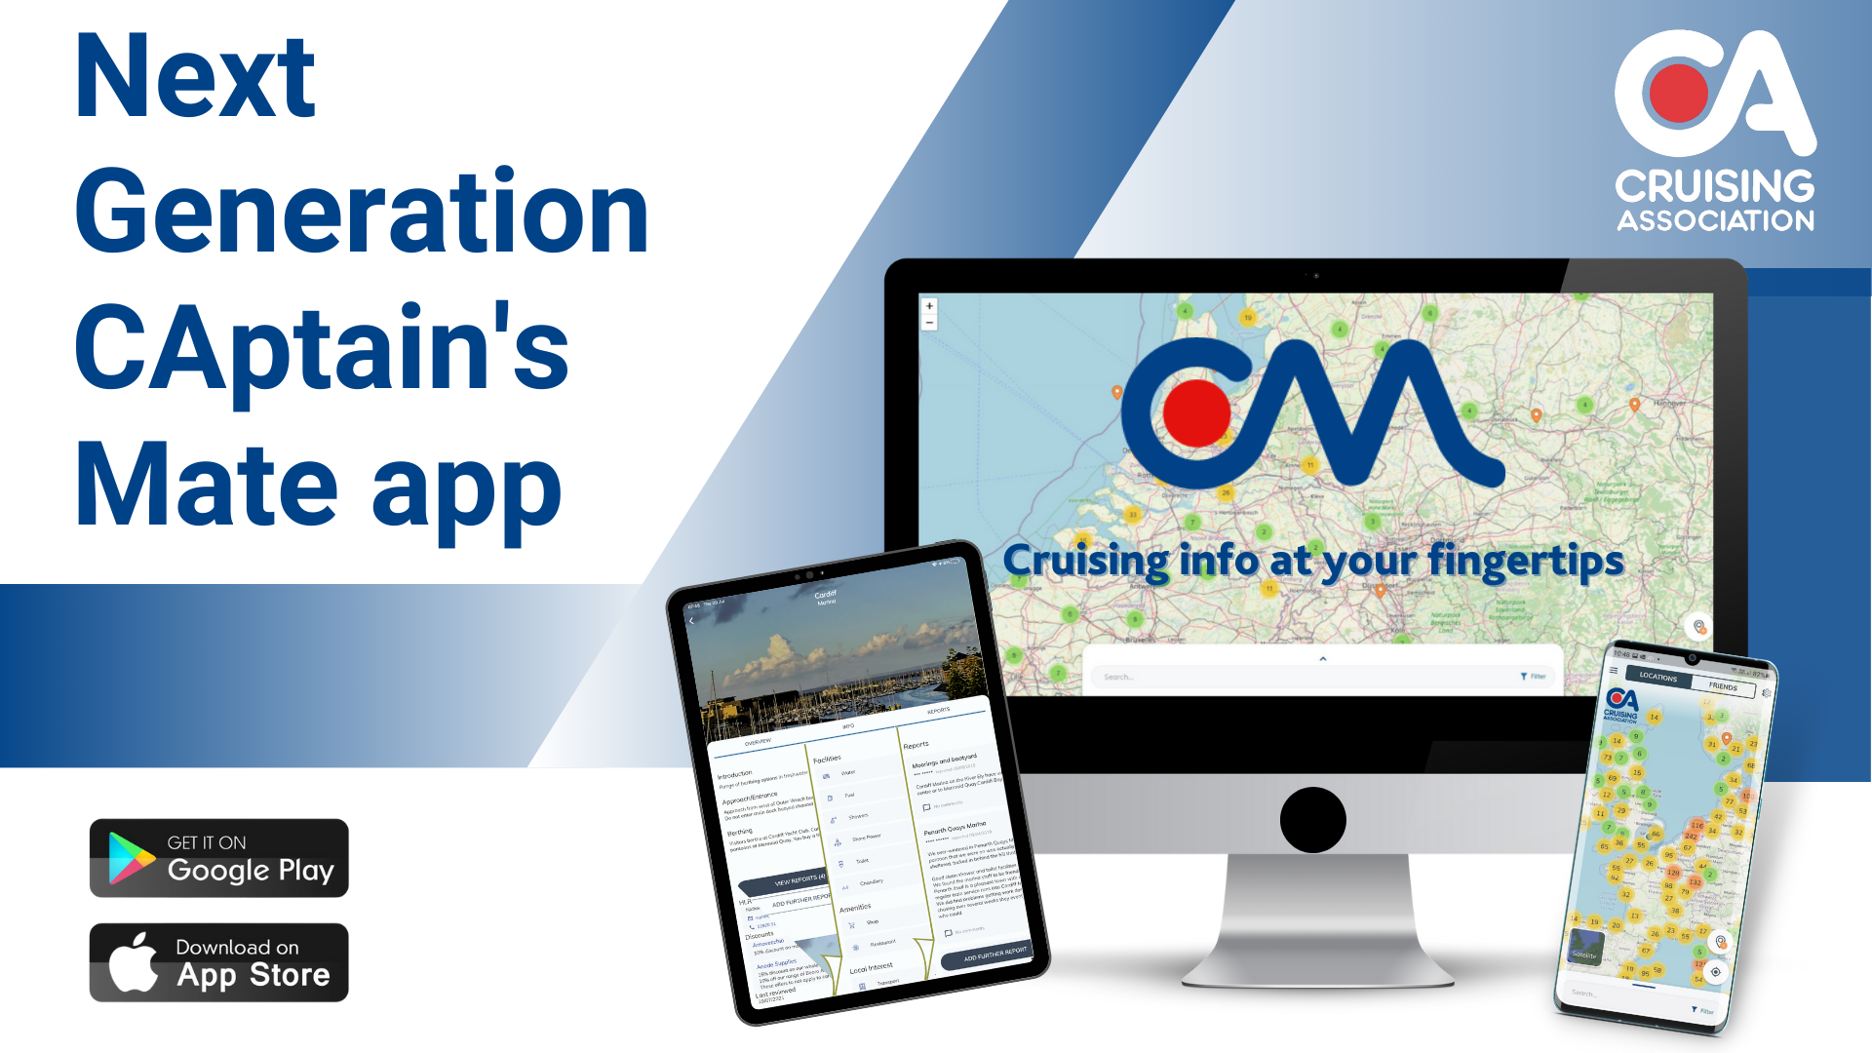
Notes:
Turning now to our exclusive, members’ only app, CAptain’s Mate.

Slide 26
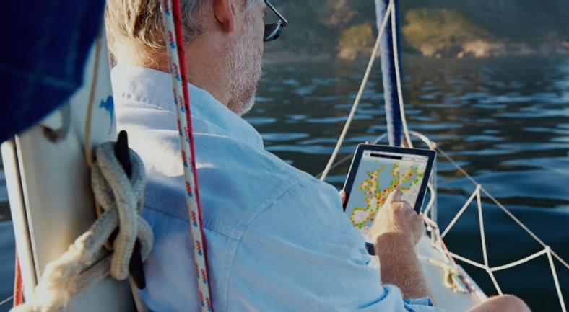
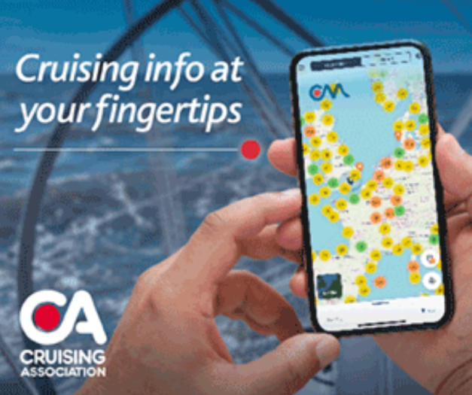
CAptain’s Mate
An app specifically designed for:
Exclusive use of CA members
Sharing location-specific information
Factual: costs, facilities, contact details, recent improvements or breakdowns …
Subjective: beauty, grumpy landlords, great restaurants, etc
Photos can be uploaded
Members can see the location of other members, if they so wish, and meet up
Notes:
CAptain’s Mate is one of the most popular benefits of CA membership. It is a web and app based tool for members to share location specific information, for use on mobile phones, tablets and computers.
Developed over a number of years, there are now over 17,000 reports from over 7,500 locations in over 100 countries around the world. The reports are edited by our regional experts, and the information provided by members can be either factual (for example, the HM phone number has changed, the pontoons have hoops not cleats) or subjective (it’s a beautiful spot, the food at the Dog and Duck is great value, the landlord at the Dick Turpin is apt to be grumpy – service is very slow).
Information is also given on the approach to the location, facilities and services and we are also adding access information, for those with a physical disability.
CM also shows members where other members are cruising, if they wish to show that information, to facilitate meet ups.

Slide 27
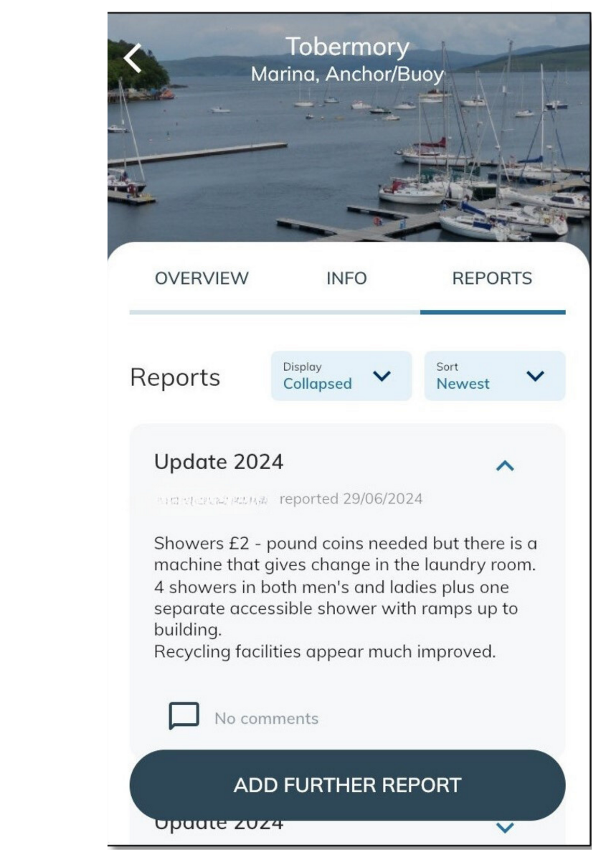
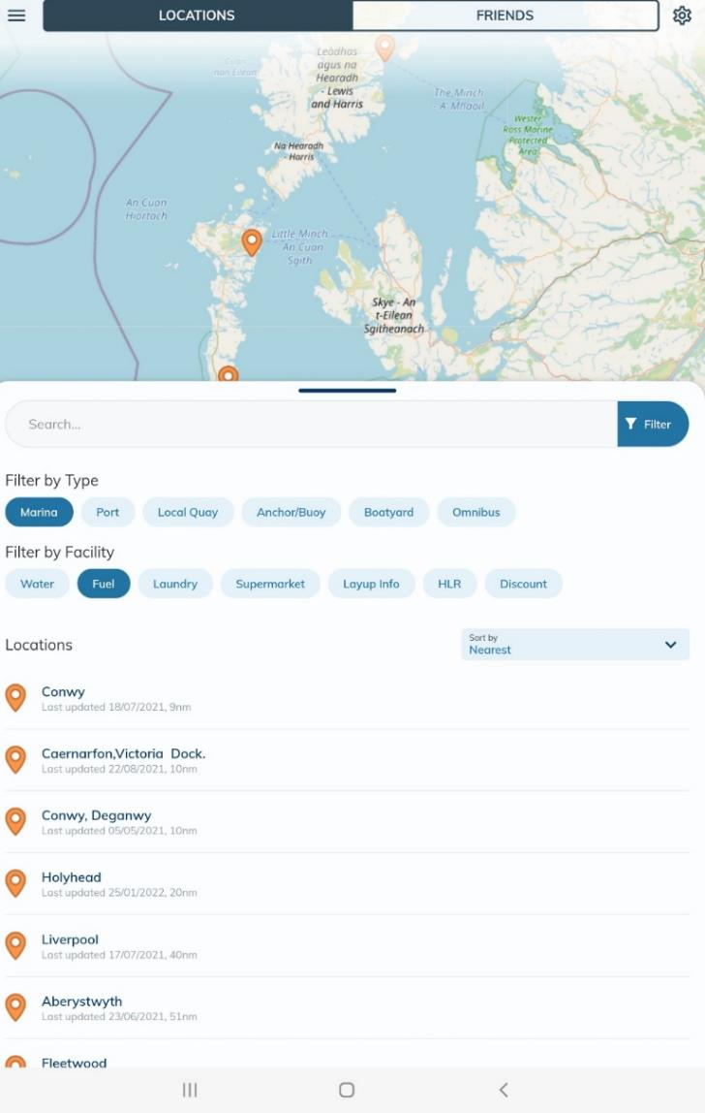
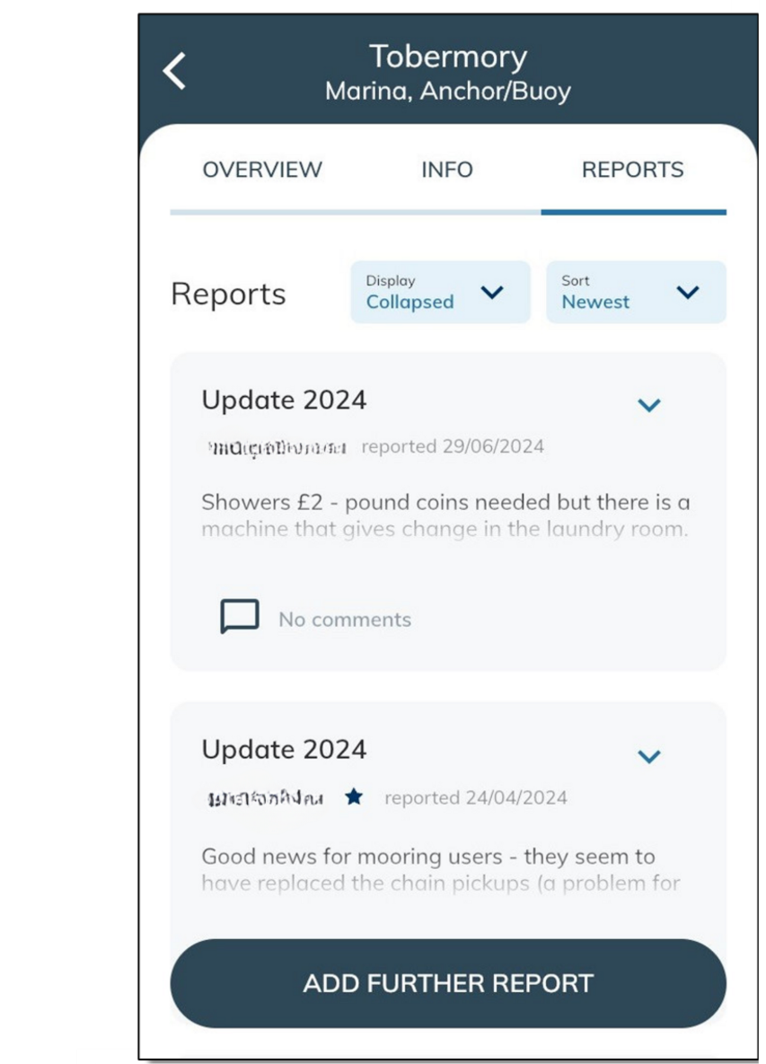
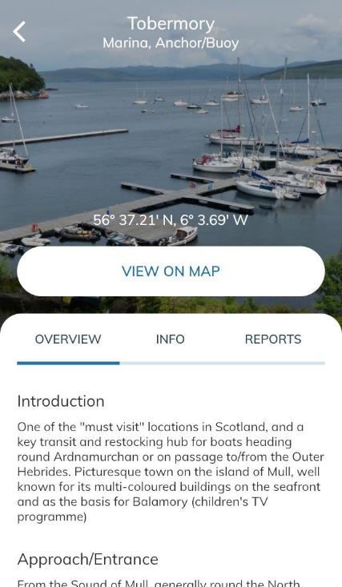



CAptain’s Mate
Notes:
*NB Animated Slide – to show the app’s functionality, pretend to click on ‘Tobermory’, then ‘Info’, then ‘Reports’*
The app is intuitive: you click on a report, and can view pilotage information first, then information about facilities available, then members’ reports. You can add reports, and photographs, and review details about the presence and contact details of Honorary Local Representatives (HLRs). You can filter your results to show specific facilities or amenities that you require. This animated slide shows the sort of information you can review.
Many people use the app on their phones or tablets while cruising. Information is downloaded to your device, so you don’t need an internet connection to view it. Members can also use the web version on their home computers to plan cruises. ‘

Slide 28


Notes:
*NB Animated Slide – to show the app’s functionality, pretend to click on ‘Tobermory’, then ‘Info’, then ‘Reports’*
The app is intuitive: you click on a report, and can view pilotage information first, then information about facilities available, then members’ reports. You can add reports, and photographs, and review details about the presence and contact details of Honorary Local Representatives (HLRs). You can filter your results to show specific facilities or amenities that you require. This animated slide shows the sort of information you can review.
Many people use the app on their phones or tablets while cruising. Information is downloaded to your device, so you don’t need an internet connection to view it. Members can also use the web version on their home computers to plan cruises.‘

Slide 29






Honorary Local Representatives (HLRs)
Notes:
Turning now to our excellent network of Honorary Local Representatives (HLRs).
These screen shots show the location of HLRs via CAptain’s Mate – you can search for HLRs, view on the map function, view by specific location and on the website you can also view the complete list by country. Here are some examples of HLR locations, shown by the person pin.

Slide 30

Honorary Local Representatives (HLRs)
From Aalborg to Ventspils via Helsinki, Halifax (Nova Scotia) and Hamble, from Iceland to Tonga and Puerto Rico to Wellington (New Zealand)
Over 200 HLRs worldwide, covering more than 60 countries
HLRs are volunteers who will assist members with local problems and provide cruising information to the CA
They are often locals who know the cruising area well, and have good connections to the local marine industry and experts
Notes:
The CA has over 200 HLRs in more than 60 countries around the world, who are there to help members as required. If they can't help themselves, they'll know someone who can.
They also keep us up-to-date with matters arising in their areas that might concern CA members – for example, the latest on immigration arrangements for French Ports of Entry.
They help with things where local knowledge is important - like sourcing emergency repairs and explaining local customs and bureaucracy.

Slide 31


Crewing Service
“To keep a Register of Owners who are prepared to take amateur crews aboard their craft” (from CA Objectives 1908)
Current Crewing service normally meets 1st Thursday of the month from October to April at CA House, and on occasional weekends – with Zoom capability
Any CA Member can register as a skipper
Crewing Service Members can register as crew
Service intended to provide introductions only
Notes:
Turning now to the CA’s Crewing Service.
In 1908 frustrated gentleman owners were looking for reliable crew and one of the CA’s earliest objectives was “to keep a register of owners who are prepared to take amateur crews aboard their craft”.
This still happens, and the CA effectively provides an ‘introduction service’ for skippers seeking crew and vice-versa. Monthly meetings take place over the winter, and by Zoom, to allow skippers and potential crew to meet and discuss their respective plans and requirements.

Slide 32



Crewing Service
Get your sailing plans sorted for the season
Don’t have a boat but are dying to get on the water?
Take a look at the Crewing Service
From just £34 per year you can connect with skippers looking to sail around the cans at weekends, cruise in international locations and even cross oceans!
Notes:
Here is an advertisement we used at the last Southampton Boat Show to showcase the Crewing Service (the annual membership is £34 paying by Direct Debit).

Slide 33



CA House
Notes:
Turning back to CA House in Limehouse, London. Apart from being a superb place to have a drink outside in the summer, it provides members with:
a library, which has already been described;
a bar and galley (restaurant) at reasonable prices;
a room where lectures and events are held;
5 ensuite cabins at a very good rate for central London! It also includes a basic, self-service breakfast.
CA House is 10 mins walk from Limehouse DLR Station, 2 stops down from Bank or Tower Gateway. The No 15 bus goes direct to Limehouse Station from Charing Cross.

Slide 34




CA House
Notes:
Here is the bar and conference room set out for one of our formal events. The room can be hired by members (and by non-members) by arrangement for personal events.

Slide 35

En suite Cabins at CA House
Single room / £60
Double room / £70
Includes self-service breakfast
Free secure parking
Notes:
Here is one of our cabins. They are quite small, but en suite and very good value for central London at £60/night for single occupancy and £70/night for double.
Members booking Friday, Saturday and Sunday night are entitled to one free night and will only pay for 2 nights (3 for 2 'Weekend Special').
Free, secure parking is available on a first-come, first-served basis if you have booked a cabin.
There are tea and coffee making facilities, and there is a common room (‘mess’) where cereals/bread and jam are provided to make your own breakfast in the morning.
Members and their guests can stay.

Slide 36

Marine Partner Discounts
A few examples:
Insurance: Pantaenius, Topsail, Haven Knox-Johnston
Equipment: LeeSan, Tek-Tanks, Ship Shape Bedding, Bruntons, ASAP Supplies
Sail Makers: Crusader, Dolphin, Hyde, Jeckells, Rolly Tasker, Ullman Sails
Charts & Books: Imray, Adlard Coles, Fernhurst Books
Visitors’ Berthing: Royal Clarence (Gosport), Universal (Hamble), Cherbourg - all 20%
Notes:
Turning now to discounts. Over the years the CA has negotiated a wide range of discounts with marine suppliers all over the world. The list is growing all the time so do check if you are a member!
It is not unusual for members to make back their annual CA membership from these discounts every year.
Here are some examples of UK-based discounts, but there are many more from around the world. Also, many of the UK suppliers ship worldwide to cruising sailors.

Slide 37




Cruising Magazine
Quarterly members’ magazine packed with useful info and interesting articles
Notes:
One of the pleasures of CA membership is the quarterly arrival of Cruising, the CA’s in house magazine. It is packed with articles of interest to the cruising sailor. Cruising can also be read online via the website as a flip-book, or downloaded as a pdf file.

Slide 38



Monthly Newsletters
xxxxxxxxx
xxxxxxx
xxxxxx
xxxxx
xxx
xxxxx
xxxxxxx
xxxxx
xxxxxxxxxxxx
xxxxxxxxxx
xxxxxxxxx
xxxxxxxxx
xxxxx
xxxxx
Notes:
In addition to the quarterly magazine, there are monthly email newsletters, keeping members up to date with CA events and matters of interest.
A Yearbook is also provided once a year with much information about the CA, together with members’ contact details.

Slide 39

Other Member Benefits
Get help on a variety of subjects ranging from technical data to weather
Examples of ‘Members’ Forum’ knowledge sharing:
Boat Transport to the Med
Calor 4.5kg availability
Insurance Conundrum
Navionics dealer in Sardinia
Tidal Gate timing
New EU Skipper Qualification
Water Makers
Yacht agent turkey
EU returning goods status
Health certificate for Greek visa
Notes:
There are a number of other membership benefits.
Firstly, there are many very active forums on the CA website, with various subjects where Members can ask questions, seek advice or exchange information.

Slide 40




Other Member Benefits
Entitlement to fly (wear) a defaced blue ensign
Notes:
Secondly, once you become a member, you can apply to fly (or wear) the CA’s blue defaced ensign with its burgee.

Slide 41




Other Member Benefits
Prize competitions: logs, photos and prize draws
Information centre: extensive member logs for reference, chart catalogues and book reviews (the CA website has 25,000+ information pages)
Links to members’ blogs and vlogs
Video and image database
Weekly lectures, many Zoom-enabled
Notes:
Thirdly, the CA holds regular prize competitions, and there are yearly prizes for the best logs of cruises in various categories, as well as prizes for photographic logs, blogs, v-logs and websites.
In addition to its library, the CA provides other resources such as members’ past logs, chart catalogues, book reviews, and access to video and photographic databases.

Slide 42




Other Member Benefits
Lectures, seminars and training
Our training partner
Notes:
Fourthly, in addition to our many lectures and events (many of which can be viewed by Zoom), training is offered for a discounted fee with our training partner, First Class Sailing.

Slide 43



Other Member Benefits
Online Shop
Notes:
Finally, as you might expect, the CA has an online shop which contains CA-branded merchandise, publications and flags and burgees for purchase by members.

Slide 44

Summary of CA Membership Benefits
Regulatory
+ Technical Advice
Honorary Local Reps (HLRs)
Lectures Seminars Training
London Clubhouse +
Cabins
Cruising +
Local Sections
Cruising magazine + newsletter
100s of Discount Partners
Maritime + Information Library
Event Programme
CAptain’s Mate
Website +
Forums
Sharing Information
Notes:
Here is a final slide summarising just some of the key benefits of CA membership.

Slide 45



Annual Membership Fees
  Full membership £163* per person or couple
  Young membership £28* (ages 18-25)
  Crewing Service £34* per person / £55* for a couple
20% discount off first year if referred by a current Member, or
15% discount off first year if member of affiliate owner associations, yacht clubs or maritime institutions (see website)
Our marine discounts often cover the cost of membership!
*Direct Debit
Notes:
The CA works very hard to keep the costs of its extensive service down. Volunteers do a great deal of the work.
The 2024 membership fees are shown. A couple can share joint membership.
You can get a discount off your first year as shown.
Do also bear in mind that many members make back their annual membership fee through use of the CA’s negotiated discounts.

Slide 46


“Sharing of information has been the lifeblood of the CA since its inception in 1908 and with thousands of members reporting on their experiences, the CA is an invaluable cruising resource and network”
Sir Robin Knox-Johnston CBE RD
Patron
Notes:
To conclude, I leave you with words from our Patron, who has always had a close involvement with the CA and continues to be a great supporter.

Slide 47


Welcome to the CA
From its origins in 1908 to the future of cruising ….
Whether you are just starting out cruising UK waters, planning European Inland Waterways trips or planning blue water sailing adventures - the benefits of Cruising Association membership are many and varied.
Questions?
Notes:
I hope this talk has provided an interesting overview of the CA’s origins and what it offers members today. The Cruising Association really feels that it is leading on the future path of cruising, supporting its members wherever they are cruising.
Thank you for listening. I would now be very happy to take any questions.

